Slide 1

AUTONOMOUS VEHICLE CONTROL SIMULATION
Using Virtual Base Classes and Inheritance — Benchmarked Against Conventional Modular Programming for Enhanced Software Reusability
DSA0106 -OBJECT ORIENTED PROGRAMMING WITH C++
Guided by,
Presented By,
CHEREDDY HARITHA(192425280)
CHIDELLA SAHASRA(192472078)
MATTA NIHARIKA(192472392)
B.SIVA PARVATHI(192525194)

Slide 2


ABSTRACT
This project develops a simulated autonomous vehicle control system using C++.
The vehicle can start, stop, move, turn, and detect simulated obstacles.
Object-Oriented Programming (OOP) uses classes, inheritance, virtual base classes, and polymorphism.
A conventional modular version is developed using separate functions.
Both approaches are compared based on reusability, maintainability, execution time, memory usage, and scalability.

Slide 3
PROBLEM STATEMENT
Conventional vehicle-control programs often repeat common control logic.
Code duplication makes the system difficult to maintain.
Adding new vehicle features requires changes in multiple functions.
The project needs a reusable and scalable vehicle-control design.
Therefore, OOP is compared with modular programming using execution time, memory usage, maintainability, reusability, and scalability.

Slide 4
OBJECTIVES
To develop a basic autonomous vehicle control simulation using C++.
To apply classes, inheritance, virtual base classes, and polymorphism.
To simulate navigation, movement, and obstacle detection.
To implement the same vehicle operations using conventional functions.
To compare both approaches using software design and performance parameters.

Slide 5
PROPOSED SYSTEM
The proposed system uses Object-Oriented Programming (OOP) with virtual base classes, inheritance, and polymorphism to build a reusable vehicle control simulation.
A common Vehicle base class is shared by the Sensor and Navigation classes, reducing code duplication and improving software organization.
The system simulates key vehicle functions such as start, stop, movement, turning, and obstacle detection while providing a flexible and maintainable design.
It also compares the OOP and modular approaches based on code reusability, maintainability, execution time, memory usage, and scalability to evaluate their effectiveness.

Slide 6






TWO DESIGNS, ONE VEHICLE
SYSTEM ARCHITECTURE
OBJECT-ORIENTED DESIGN
Sensor Class (Virtual Base)
Control Functions:
Start, Stop, Move, Turn,
Obstacle Detection
Vehicle
(Base Class)
AutonomousCar Class
Navigation Class (Virtual Base)
Sensor and Navigation both virtually inherit Vehicle; AutonomousCar virtually inherits both — the diamond pattern virtual base classes resolve.
MODULAR PROGRAMMING DESIGN
Start Vehicle
Move Vehicle
Obstacle Detection
Stop Vehicle
Comparison
Result Display
Parameters Tracked in Both Designs:
Vehicle Speed • Obstacle Detection • Navigation Direction • Vehicle Status

Slide 7
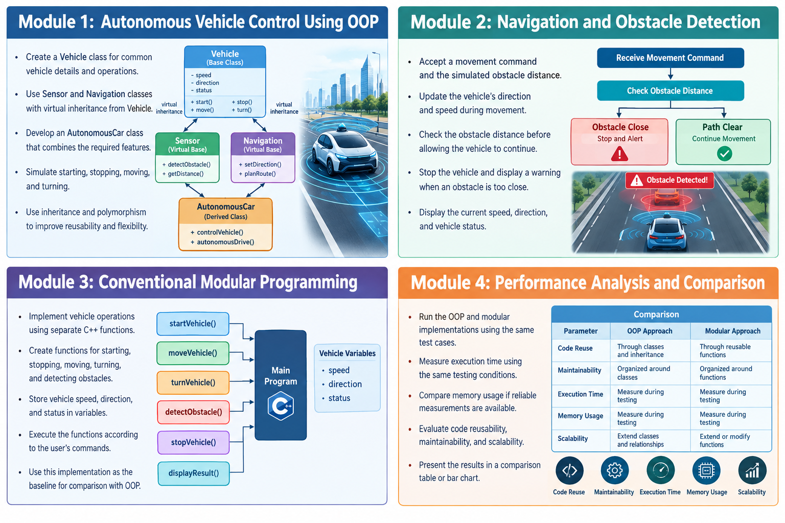
MODULE 1: AUTONOMOUS VEHICLE CONTROL USING OOP
Create a Vehicle class for common vehicle details and operations.
Use Sensor and Navigation classes with virtual inheritance from Vehicle.
Develop an AutonomousCar class that combines the required features.
Simulate starting, stopping, moving, and turning.
Use inheritance and polymorphism to improve reusability and flexibility.

Slide 8
MODULE 2: NAVIGATION AND OBSTACLE DETECTION
Accept a movement command and the simulated obstacle distance.
Update the vehicle's direction and speed during movement.
Check the obstacle distance before allowing the vehicle to continue.
Stop the vehicle and display a warning when an obstacle is too close.
Display the current speed, direction, and vehicle status.

Slide 9
MODULE 3: CONVENTIONAL MODULAR PROGRAMMING
Implement vehicle operations using separate C++ functions.
Create functions for starting, stopping, moving, turning, and detecting obstacles.
Store vehicle speed, direction, and status in variables.
Execute the functions according to the user's commands.
Use this implementation as the baseline for comparison with OOP.

Slide 10
MODULE 4: PERFORMANCE ANALYSIS AND COMPARISON
Run the OOP and modular implementations using the same test cases.
Measure execution time using the same testing conditions.
Compare memory usage if reliable measurements are available.
Evaluate code reusability, maintainability, and scalability.
Present the results in a comparison table or bar chart.

Slide 11
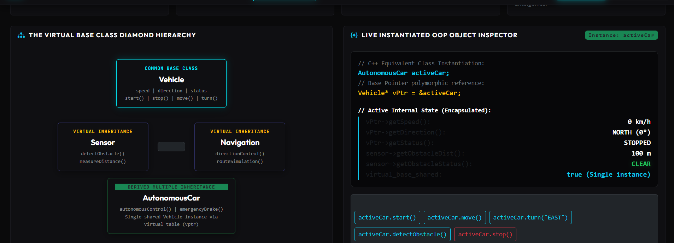
IMPLEMENTATION

Slide 12
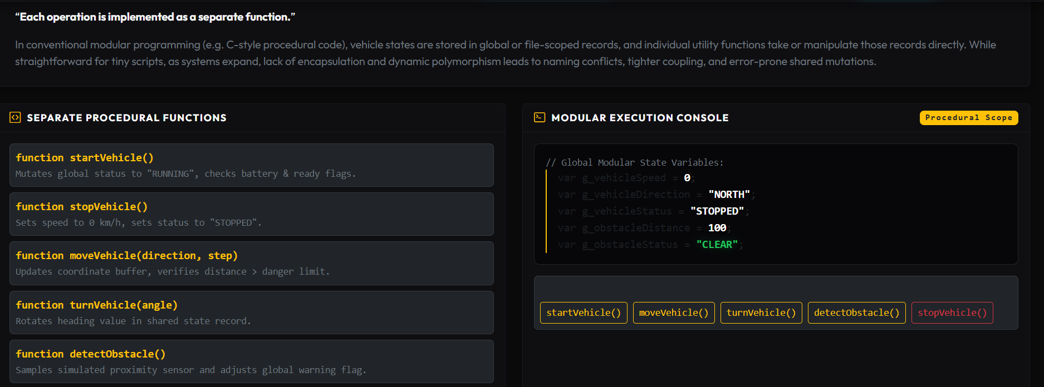
IMPLEMENTATION

Slide 13
ADVANTAGES
Reduces repeated code by sharing common vehicle features.
Makes vehicle operations easier to organize and understand.
Supports new features through classes, inheritance, and functions.
Provides a safe-stop simulation when an obstacle is detected.
Helps identify the strengths and limitations of OOP and modular programming.

Slide 14
CONCLUSION
The project demonstrates autonomous vehicle control through a C++ simulation.
OOP concepts help organize vehicle components and reuse common functionality.
Conventional modular programming provides a straightforward function-based alternative.
Performance measurements and design comparisons help evaluate both approaches.
The simulation demonstrates basic control and obstacle-handling logic; it is not a real autonomous driving system.

Slide 15


